Slide 1

Question and Answer
Your brain sends electrical signals through nerves to your muscles. This system is called the voluntary nervous system. You decide to move, and the command travels fast. Muscles are designed to respond only when you choose to act.
Cell growth is managed by involuntary processes inside your body, like hormones and genes. Your conscious mind does not talk to individual cells. Cells follow chemical instructions written in your DNA, not your thoughts.
Why we can control movements
Why we cannot control cell growth
Why we cannot stop aging and death
Why we cannot block negative
information like pain
Aging happens because cells gradually lose the ability to repair themselves. Tiny parts inside cells (telomeres) get shorter each time a cell divides. This is a built-in biological clock. No thought can turn off this clock, so we eventually age and die.
Pain is a warning signal. When you touch something dangerous, special sensors send a fast message to your brain. Your brain makes you feel pain on purpose, to protect you from injury. Automatically rejecting all pain would be harmful—you might burn your hand without knowing it.

Slide 2
From GitHub to WeChat
Be a Website Developer
Product Launch
You can download this PPT from here for free: https://user-henry.github.io/nflshcchat/Be a Website Developer.pptx

Slide 3
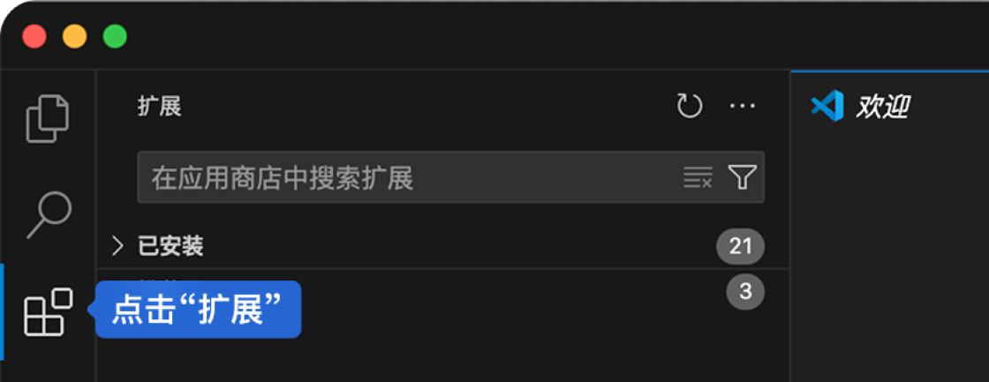
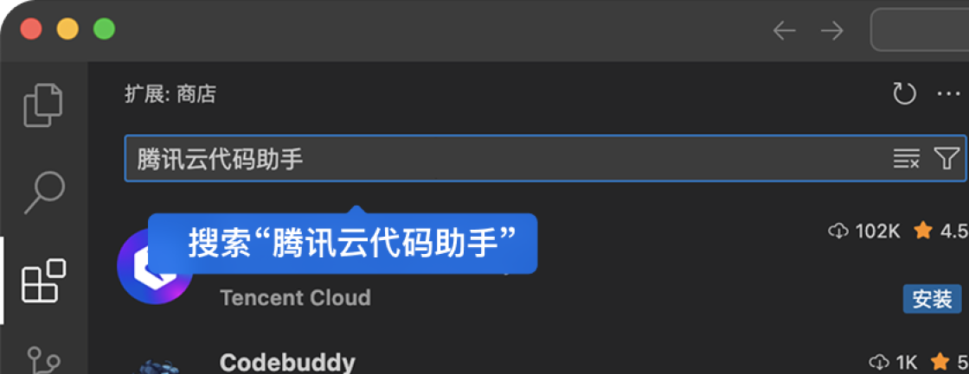


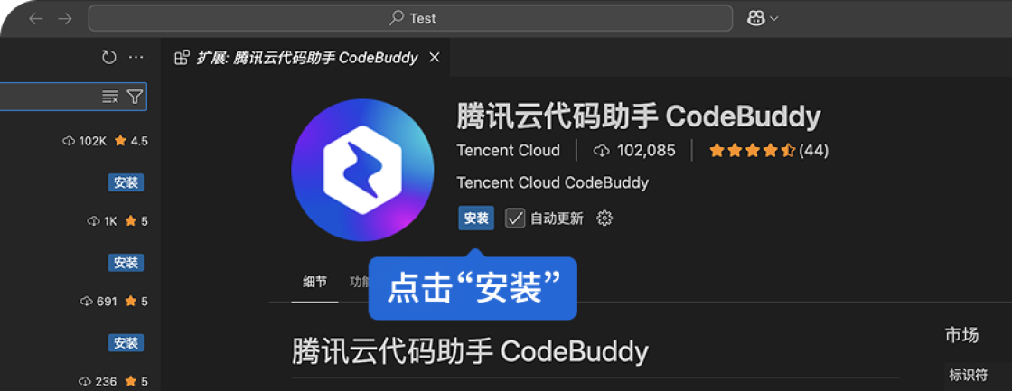
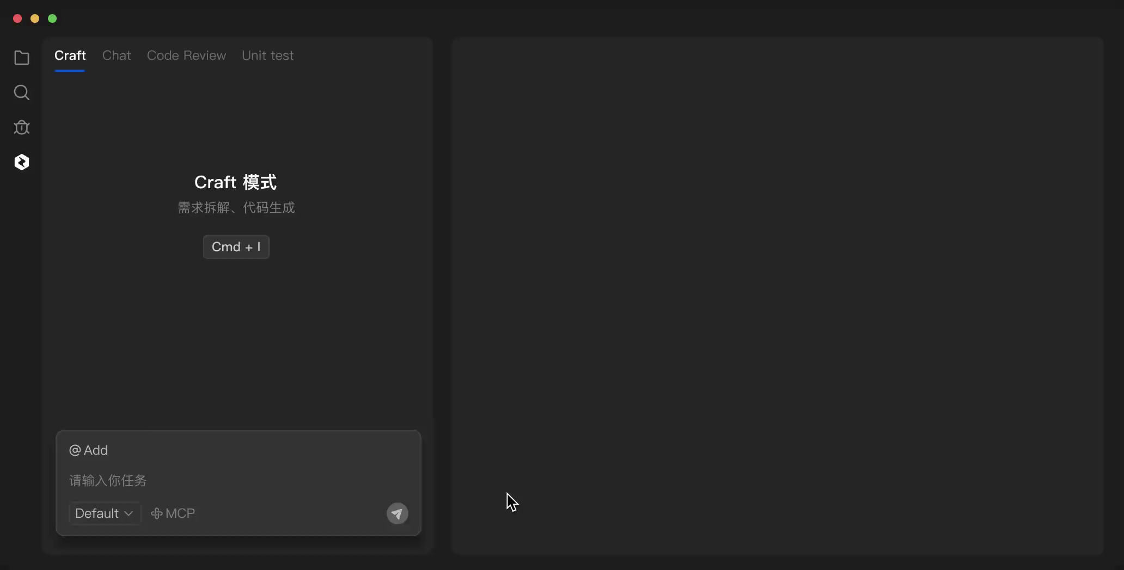
Preface
We are going to introduce some key points of website building below.
If you are very interested in building websites, don't miss it.
What should you do if you don't know how to write the code for a website? In fact, we can use OpenClaw to complete the website building process without you needing to do anything.
However, AI web automation tools are not perfect; they have many problems and are not as fast as humans. However, if we only look at coding, AI is better, so I sincerely recommend everyone to use CodeBuddy.
You can download this PPT from here for free: https://user-henry.github.io/nflshcchat/Be a Website Developer.pptx

Slide 4
CONTENTS
GitHub
APP
Other products
WeChat
Our own computer
You can download this PPT from here for free: https://user-henry.github.io/nflshcchat/Be a Website Developer.pptx

Slide 5
01
GitHub
You can download this PPT from here for free: https://user-henry.github.io/nflshcchat/Be a Website Developer.pptx

Slide 6


GitHub
If I want you to build a student chat platform for Nanjing Foreign Language School Huai'an Campus, what would be your first choice?
I will choose GitHub.
Why?
Let's watch a video.
So, I have successfully built this chat platform — NFLSHC Chat!
Now, let's take a look at how it works.
You can download this PPT from here for free: https://user-henry.github.io/nflshcchat/Be a Website Developer.pptx

Slide 7
02
APP
You can download this PPT from here for free: https://user-henry.github.io/nflshcchat/Be a Website Developer.pptx

Slide 8

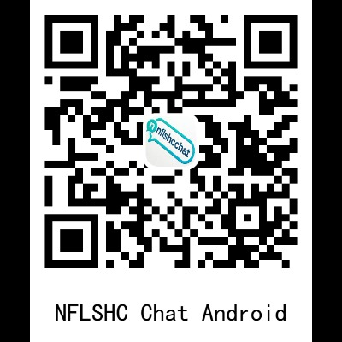

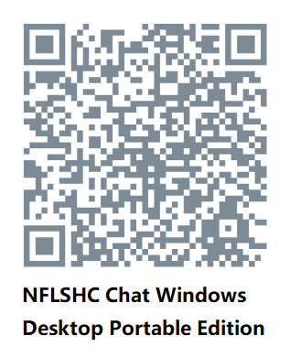
APP
But that's not enough. The programmer Lucas gave me a suggestion: WeChat is popular because it is very convenient, an app that you can use as soon as you open it.
So I made the NFLSHC Chat APP version.
So far, it only supports the Android system and Windows system.
Let's watch a video about NFLSHC Chat Windows Desktop.
You can download this PPT from here for free: https://user-henry.github.io/nflshcchat/Be a Website Developer.pptx

Slide 9
03
WeChat
You can download this PPT from here for free: https://user-henry.github.io/nflshcchat/Be a Website Developer.pptx

Slide 10


WeChat
However, GitHub Pages uses foreign servers, which results in slower loading within the country. Are there any other solutions?
Yes, for example, WeChat Mini Programs.
What is a WeChat Mini Program?
Let's watch a video.
In the end, I finished the NFLSHC Chat WeChat mini program for real-time communication.
You can follow our official account and then send your WeChat ID, so we can give you access to try out our WeChat mini program.
You can download this PPT from here for free: https://user-henry.github.io/nflshcchat/Be a Website Developer.pptx

Slide 11
04
Our own computer
You can download this PPT from here for free: https://user-henry.github.io/nflshcchat/Be a Website Developer.pptx

Slide 12
Our own computer
But WeChat mini programs have a limit on the number of users who can try them. So, are there any other solutions?
Yes, we can use our own computer as an information relay station.
How to do it?
Let's watch a video.
I have completed the development of the remote control computer web version, and everyone is welcome to try it out. This version of NFLSHC Chat is still being updated.
You can download this PPT from here for free: https://user-henry.github.io/nflshcchat/Be a Website Developer.pptx

Slide 13
05
Other products
You can download this PPT from here for free: https://user-henry.github.io/nflshcchat/Be a Website Developer.pptx

Slide 14
Other products
Problem: You copy a file path. Then copy a picture. The first copy is gone. Windows clipboard only keeps one thing. History panel (Win+V) needs manual selection, no queue.
Solution: Press Ctrl+Alt+C → add to queue.
Press Ctrl+Alt+V → paste the oldest one and remove it.
It's like a to-paste list. Copy three things, paste them one by one in order.
Tray icon shows how many items are waiting. That's ClipboardQueue.
Problem: You lock your phone or computer, but you can always unlock it early. A timer is too easy to break.
Solution: You set a real task, like "run my code test" or "write 200 words". Then you lock your computer. The lock only opens when you finish the task. If you give up, you wait a long time. No cheating. That's ProcrastinationTrap.
You can download this PPT from here for free: https://user-henry.github.io/nflshcchat/Be a Website Developer.pptx

Slide 15
Other products
Problem: You buy three kinds of apples. Each has a price tag, but the tag only shows total price, not price per item. At home, you can't remember which apple cost how much.
Solution: Take one photo of all fruit. The app finds every tag, reads the price and name, then asks how many apples you bought. It calculates the price per apple. One line of text comes out: "Red apple: 3 pieces, total $12.50, each $4.17". No more guessing. That's PriceSnap.
Problem: Screenshots only give you a picture. If you want colors or text from the picture, you need other tools. Pick one color? Use a color picker. Get text? Use an OCR tool. Too many steps.
Solution: Press Ctrl+Alt+X, then drag a box on screen. One box does three things:
1. Screenshot goes to clipboard.
2. All main colors in the box → show color blocks, click to copy HEX code.
3. All text in the box → OCR reads it, keeps line breaks and spaces, one click to copy.
No second tool. No save file first. Just one box, get everything. That's ScreenTool.
You can download this PPT from here for free: https://user-henry.github.io/nflshcchat/Be a Website Developer.pptx

Slide 16
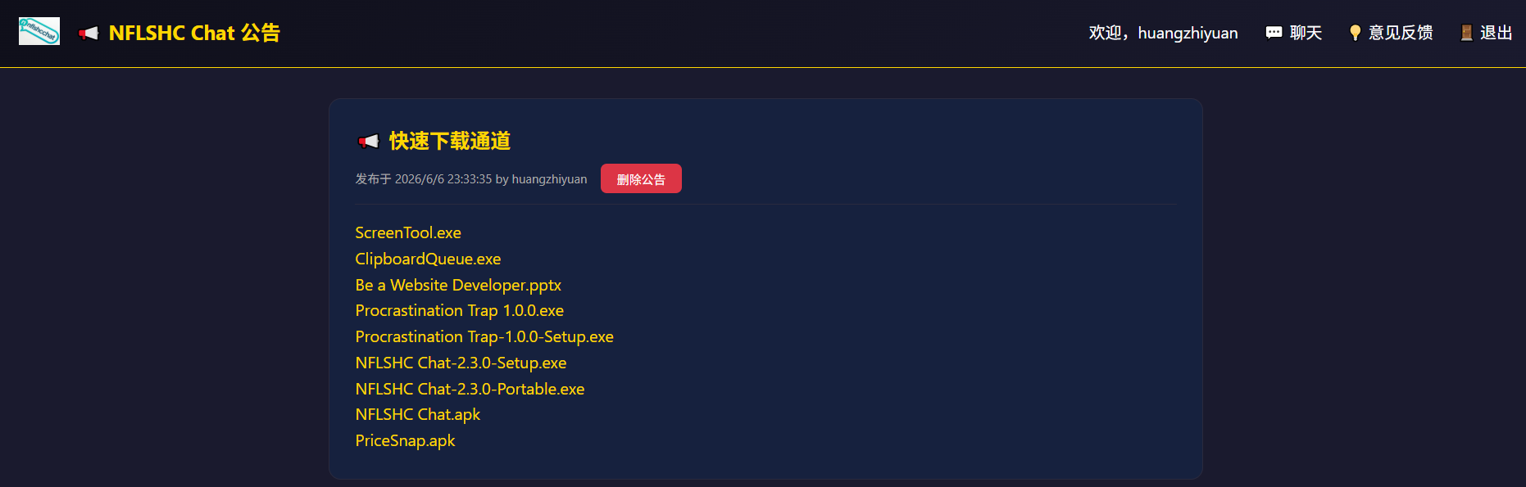
Other products
You see, there are actually many problems in life that need to be solved. We need to have eyes that can notice problems and think about how to solve them. In this way, our lives will be more full of challenges and fun (even if the code is not written by you personally).
You can download all the software mentioned above for free from the NFLSHC Chat-notice.
You can download this PPT from here for free: https://user-henry.github.io/nflshcchat/Be a Website Developer.pptx

Slide 17
Be a Website Developer
Thank you.
You can download this PPT from here for free: https://user-henry.github.io/nflshcchat/Be a Website Developer.pptx

